Slide 1
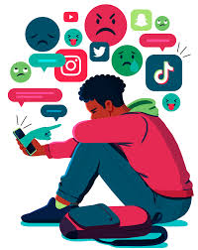
CYBER BULLYING

Slide 2
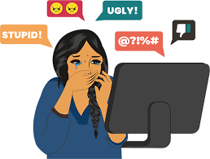
Cyberbullying is when someone uses the internet, social media, or messages to hurt, embarrass, or threaten another person. It can happen through mean comments, spreading rumors, sharing private pictures, or making fun of someone online.

Slide 3

Where Cyberbullying Happens
📱 Social Media (Facebook, Instagram, TikTok, Twitter) 📩 Messaging Apps (WhatsApp, Snapchat, Discord) 🎮 Online Games (Fortnite, PUBG, Roblox) 📧 Emails & Forums

Slide 4
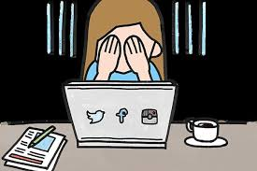
Effects of Cyberbullying
💔 Emotional Impact – Stress, anxiety, depression, or low self-esteem. 📉 School/Work Problems – Poor concentration, lack of motivation. 🚫 Social Withdrawal – Avoiding friends or public places. 😞 Self-Harm Risks – In extreme cases, it can lead to self-harm or suicidal thoughts.

Slide 5
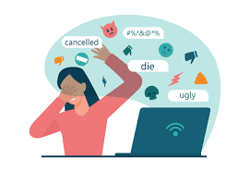
HOW TO RESPOND TO CYBERBULLYING

Slide 6

Stay Calm & Don’t React Emotionally
❌ What NOT to do:
Don’t reply with anger or insults.
Avoid arguing with the bully—it may make things worse.
✅ What to do instead:
Take deep breaths and stay calm.
Remember: Bullies want a reaction. If you don’t engage, they may lose interest.
If the message upsets you, take a break before deciding how to respond.

Slide 7
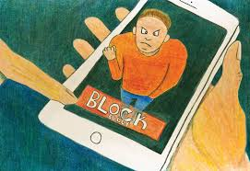
Don’t Engage – Ignore or Block the Bully
If the cyberbullying is mild, sometimes the best response is no response.
How to do this:
Ignore them – Sometimes, bullies lose interest if you don’t react.
Block them – Most platforms allow you to block users so they can’t contact you.
Use Privacy Settings – Adjust your settings so only trusted friends can message or tag you.

Slide 8

How to Block Someone on Common Platforms:
Instagram: Go to their profile → Tap "..." → Select Block
Facebook: Go to their profile → Tap "Friends" → Select Block
WhatsApp: Open chat → Tap contact name → Scroll down → Select Block
TikTok: Go to their profile → Tap "..." → Select Block
Snapchat: Hold down their name → Tap More → Select Block

Slide 9

Document & Save Evidence
If the bullying continues, keep proof to report it later.
What to save:
Screenshots of offensive messages, posts, or comments.
URLs of harmful content.
Dates and times of incidents.

Slide 10
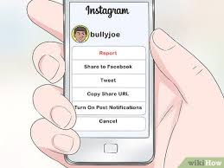
Report the Cyberbullying
Most websites, apps, and schools have rules against bullying. You can report the bully to:
Social Media & Gaming Platforms
Every major platform has a "Report" button for harmful content.
Platforms like Facebook, Instagram, Twitter, and TikTok take action against bullying.

Slide 11

School or Workplace Authorities
If cyberbullying involves classmates or colleagues, inform your teacher, school counselor, or HR department.

Slide 12

Cybercrime Authorities (For serious cases)
If the bullying includes threats, blackmail, harassment, or leaked personal photos, report it to law enforcement or cybercrime helplines in your country.

Slide 13
Talk to Someone & Get Support
Cyberbullying can be emotionally painful. Don’t deal with it alone!
Who to talk to:
Parents or Guardians – They can guide you on what to do next.
Teachers or School Counselors – If bullying happens at school, they can help.
Friends – Talking to close friends can give you emotional support.
Mental Health Professionals – If you feel anxious or depressed, seek professional help.

Slide 14


Slide 15
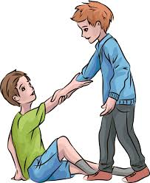
Stand Up for Others
If you see someone being bullied online, don’t be a silent bystander.
What you can do:
Support the victim – Send them a kind message.
Report the bully – Even if it’s not happening to you, reporting helps stop it.
Encourage the victim to seek help – Remind them they are not alone.

Slide 16

Be Proactive & Stay Safe Online
Prevent cyberbullying before it starts!
Tips for Online Safety:
Think Before You Post – Avoid sharing too much personal information.
Use Strong Passwords – To prevent hacking or fake accounts in your name.
Be Selective with Friends – Only accept requests from people you trust.
Keep Accounts Private – Adjust privacy settings on social media.

